Slide 1
Number Plate Recognition System
22AIE205-Introduction to Python

Slide 2
Agenda
01
03
02
04
Overview
Code
Methodology
Output & Refrences

Slide 3
01
OVERVIEW

Slide 4
INTRODUCTION
Automatic License Plate Recognition (ALPR) systems have become integral in modern computer vision applications, playing a crucial role in various fields such as law enforcement, traffic monitoring, and urban planning. This project focuses on the development of an ALPR system using the OpenCV library, aiming to provide an efficient and accurate solution for license plate detection and recognition.

Slide 5
—Challenges & solution
Dealing with bright and dark objects
Dealing with noisy images
Dealing with non-standard number plates

Slide 6
—Further System Development
Merging Python libraries with image processing,
Addressing variations in size, font, color, and background,
Real-world testing

Slide 7
Further Improvements
Security
Database
Models
Data Diversity
Secured code for building a strong firewall
Creating a strong database for data storage
Enhancing the Advanced Machine Learning Models
Training to compute with various types of number plates

Slide 8
02
Methodology

Slide 9
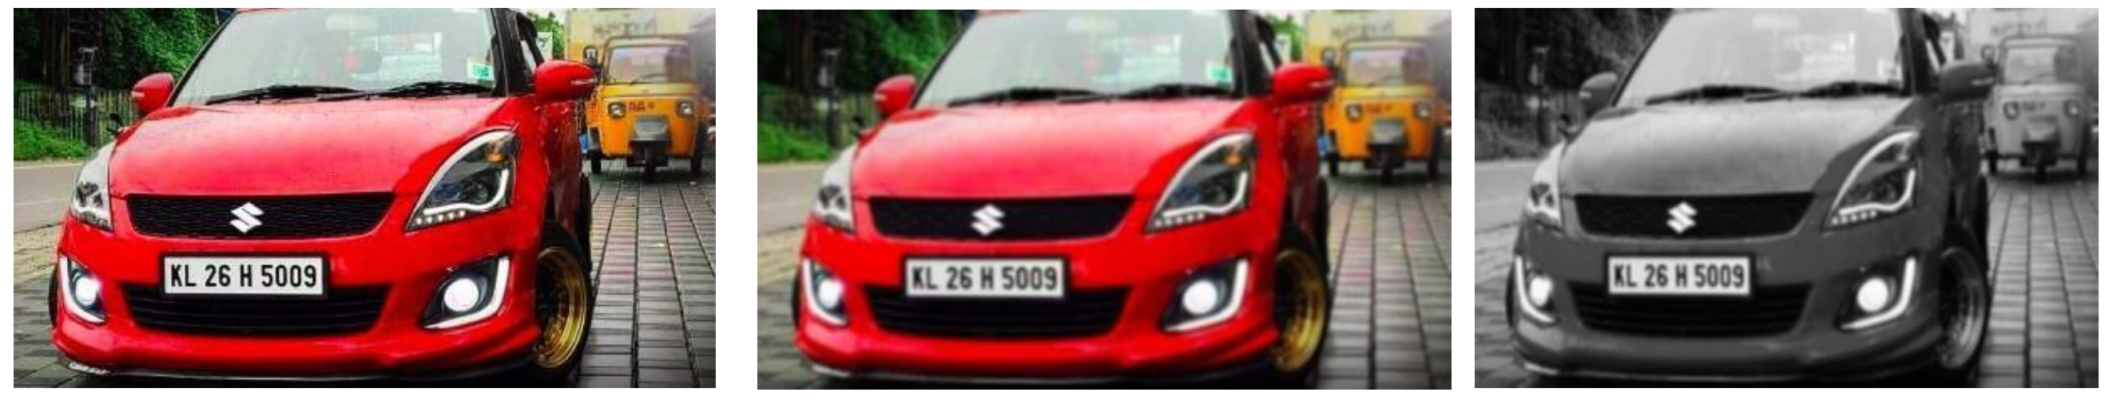
Image pre-processing
Image pre-processing can be done by Noise reduction, RGB to Grayscale conversion, Edge detection using Sobel method, Under-sampling, Morphological transformation

Slide 10
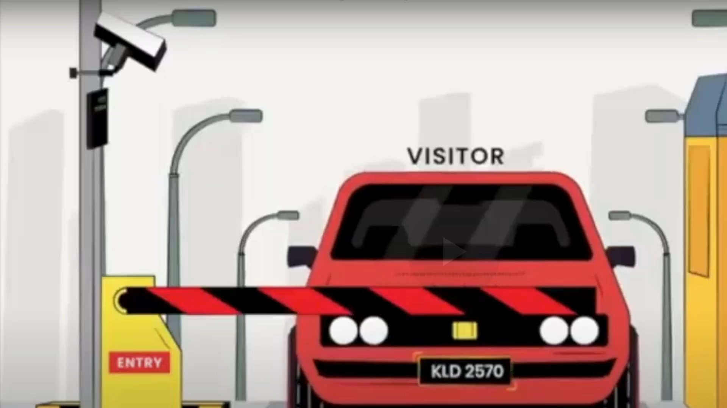
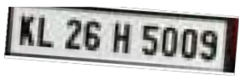
Number plate detection
Apply Counters, Contour Tracing, also called as Border following is the algorithm used for generating Contours.
Filter Contours and extract the region of interest, Number plate recognition, For small regions, especially sharp edges and noise outliers, contours are applied.
0:50 / 2:50
#Indian Number Plate Recognition System
Indian Number Plate Recognition System
300 views
Number Plate Detection
Team - 14
SUBSCRIBE 2.0 M

Slide 11
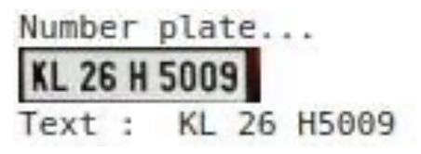
Number plate Recognition
Number plate de-skewing, Skew is the amount of rotation necessary to return an image to horizontal and vertical alignment. Skew is measured in degrees.
Pre-process region of interest, Python-tesseract is an optical character recognition (OCR) tool for python. That is, it will recognize and “read” the text embedded in images.
0:50 / 2:50
#Indian Number Plate Recognition System
Indian Number Plate Recognition System
300 views
Number Plate Detection
Team - 14
SUBSCRIBE 2.0 M

Slide 12
03
Code

Slide 13
main.py
This code implements an Automatic License Plate Recognition (ALPR) system using Python and OpenCV. It's designed to:
1. Load necessary libraries (`cv2`, `numpy`, `os`) and custom modules/classes (`Main`, `DetectChars`, `DetectPlates`, `PossiblePlate`).
2. Define color scalar constants for use in drawing shapes.
3. Provide functions to:
- Draw a red rectangle around a detected license plate on an image.
- Write recognized characters from a license plate on the original image near the plate.
4. The `main()` function orchestrates the process:
- Loads KNN data for character recognition.
- Reads an image of a car scene.
- Detects possible license plates in the scene.
- Recognizes characters in the identified plates.
- Displays the original scene, detected plate, thresholded plate image, and recognized characters.
5. Finally, if the script is run directly (`__name__ == "__main__"`), it calls the `main()` function to execute the ALPR process.
**Overall, this code performs a series of operations to identify license plates in images and extract the characters from those plates for further processing.

Slide 14
detectchars.py
1. Imports necessary libraries: `os`, `cv2`, `numpy`, and modules/classes like `Main`,`Preprocess`, `PossibleChar`.
2. Constants: Defines various constants used in the character recognition process.
3. Functions:
- `loadKNNDataAndTrainKNN`: Loads data for K-nearest neighbors (KNN) algorithm and trains the model.
- `detectCharsInPlates`: Detects characters within identified license plates.
- `findPossibleCharsInPlate`: Finds possible characters in a plate based on certain criteria.
- `findListOfListsOfMatchingChars`: Identifies lists of matching characters in a plate.
- `distanceBetweenChars`, `angleBetweenChars`: Calculate distance and angle between characters.
- `removeInnerOverlappingChars`: Removes overlapping characters within a set of matches.
- `recognizeCharsInPlate`: Recognizes characters within identified matching characters using KNN.
4. Overall Functionality:
- The script aims to process images of license plates (`listOfPossiblePlates`) to identify and recognize characters within them.
- It preprocesses the images (`preprocess`) and then extracts characters by finding contours (`findPossibleCharsInPlate`).
- Matching characters are identified based on specific criteria (`findListOfListsOfMatchingChars`), and the KNN algorithm is used to recognize
characters (`recognizeCharsInPlate`)

Slide 15
detectsplate.py
1. Imports:
- Libraries like `cv2`, `numpy`, `math`, `random`.
- Custom modules/classes for preprocessing (`Preprocess`), character detection (`DetectChars`), and handling possible plates/characters (`PossiblePlate`, `PossibleChar`).
2. Constants:
- `PLATE_WIDTH_PADDING_FACTOR`, `PLATE_HEIGHT_PADDING_FACTOR`: Factors used for calculating plate width and
height based on detected characters.
3. Functions:
`detectPlatesInScene`: Detects possible plates in a given scene by preprocessing the image, finding possible characters, and matching them - `findPossibleCharsInScene`: Identifies potential characters in a scene based on contours detected in the thresholded image.
`extractPlate`: Extracts a possible plate from the original image using a list of matching characters. It calculates the plate's position, dimensions, 4. Overall Functionality:
`detectPlatesInScene` is the primary function that orchestrates the plate detection process.
- It preprocesses the image, identifies potential characters, matches them, and extracts plates from the scene based on these matches.
- The script visualizes intermediate steps if `Main.showSteps` is set to `True`, showing contour detection, possible character identification, and plate extraction.

Slide 16
Possible char.py
- Class `PossibleChar`:
- Attributes
- `contour`: A contour representing a possible character.
- `boundingRect`: Bounding rectangle around the contour.
- `intBoundingRectX`, `intBoundingRectY`: X and Y coordinates of the top-left corner of the bounding rectangle.
- `intBoundingRectWidth`, `intBoundingRectHeight`: Width and height of the bounding rectangle.
- `intBoundingRectArea`: Area of the bounding rectangle.
- `intCenterX`, `intCenterY`: X and Y coordinates of the center of the bounding rectangle.
- `fltDiagonalSize`: Diagonal size of the bounding rectangle.
- `fltAspectRatio`: Aspect ratio of the bounding rectangle (width/height).
- Initialization
- The class is initialized with a contour. Upon initialization, it calculates various properties of the contour such as the bounding rectangle, dimensions, area, center
coordinates, diagonal size, and aspect ratio. This class seems designed to encapsulate the characteristics and properties of a single possible character contour within an image, making it easier to handle and manipulate these properties within the context of character recognition or object detection tasks.

Slide 17
Possible plates.py
- Class `PossiblePlate`
- Attributes:
- `imgPlate`: Represents the image of a possible license plate.
- `imgGrayscale`: Grayscale version of the plate image.
- `imgThresh`: Thresholded version of the plate image.
- `rrLocationOfPlateInScene`: Rotated rectangle location of the plate in the scene.
- `strChars`: String representation of characters found on the plate.
- Initialization:
- The class is initialized without any parameters. Upon initialization, it createsplaceholders for the plate image, its grayscale and thresholded versions, the location of the plate in the scene (as a rotated rectangle), and an empty string to store the characters recognized on the plate. This class seems designed to encapsulate the data and properties related to a possible license plate detected in an image. It provides a structured way to store and manipulate information about a potential license plate during the process of automatic license plate recognition or detection.

Slide 18
preprocess.py
1. Preprocess Function:
- Takes an original image as input.
- Converts the image to grayscale using the `extractValue` function.
- Maximizes the contrast of the grayscale image using the `maximizeContrast` function.
- Blurs the contrast-maximized image using Gaussian blur.
- Applies adaptive thresholding to create a binary image.
- Returns the grayscale and thresholded images.
2. ExtractValue Function:
- Converts the original image from BGR to HSV color space.
- Extract the value channel (brightness) from the HSV image.
- Returns the value channel (grayscale image).
3. MaximizeContrast Function:
- Performs top-hat and black-hat morphological operations.
- Top-hat: Difference between the input image and its opening.
- Black-hat: Difference between the closing and the input image.
- Adds the input image and top-hat, then subtracts black-hat from it.
- Returns the resulting image with maximized contrast.

Slide 19
04
Output & Refrences

Slide 20
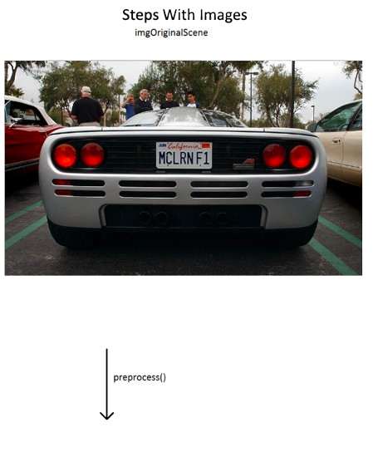
Output

Slide 21
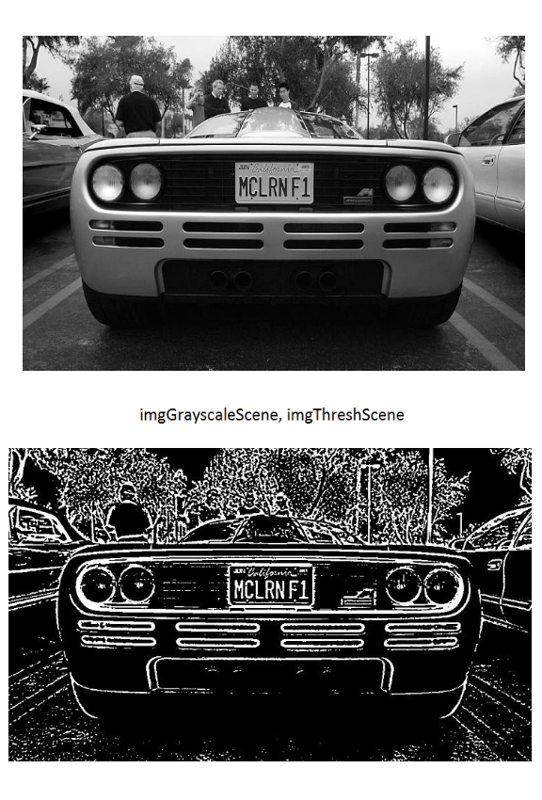
Output

Slide 22
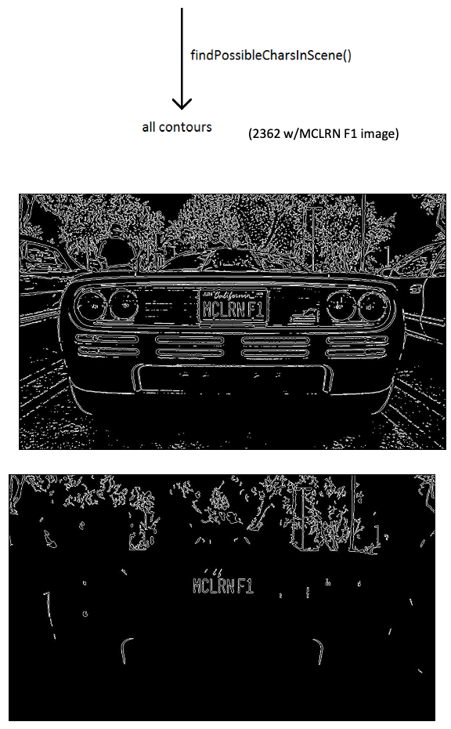
Output

Slide 23
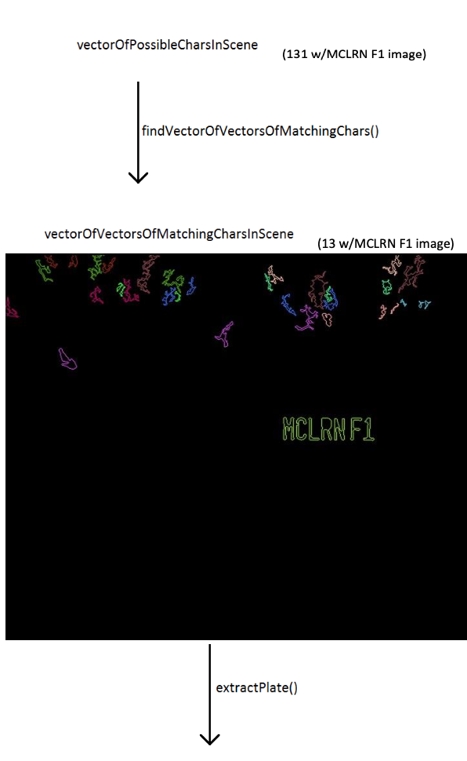
Output

Slide 24
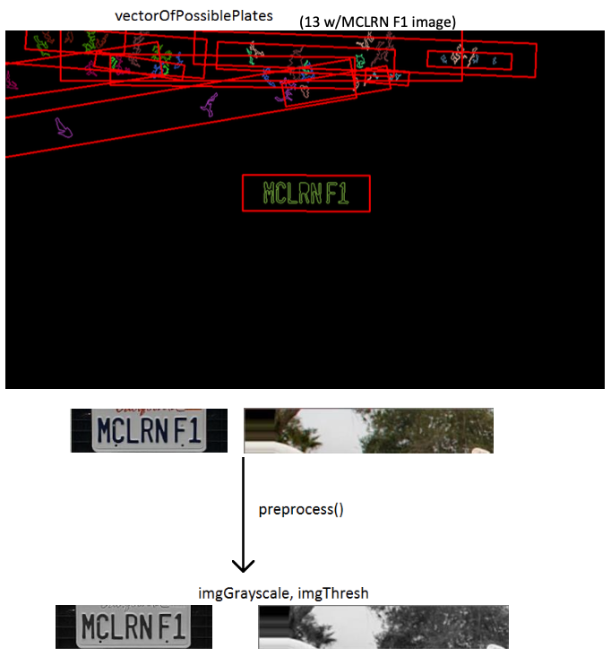
Output

Slide 25
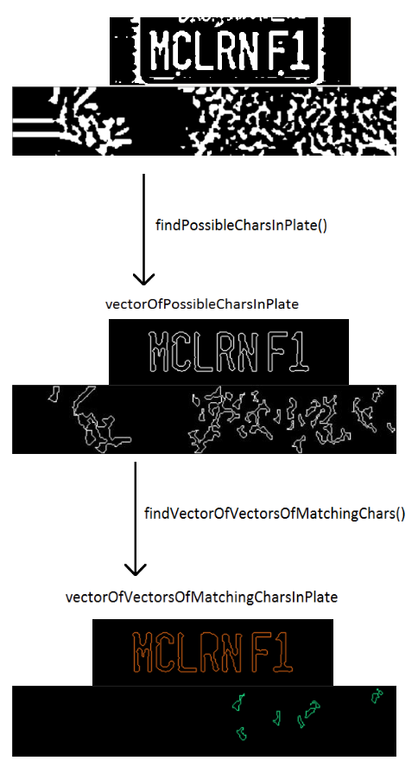
Output

Slide 26
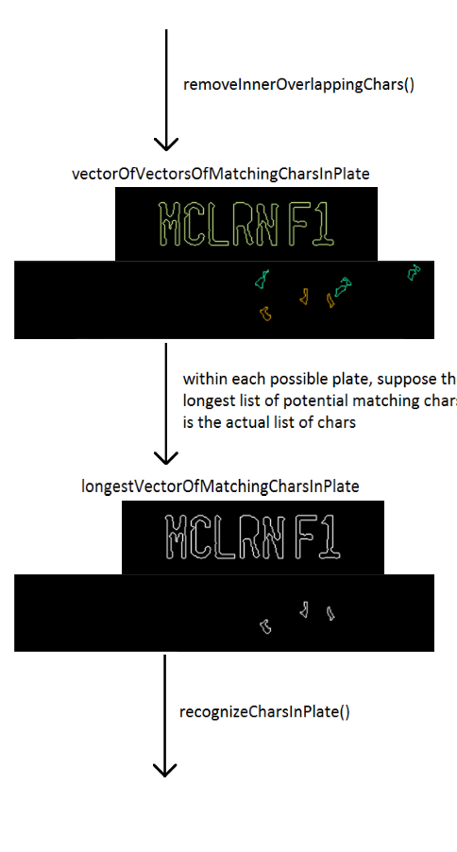
Output

Slide 27
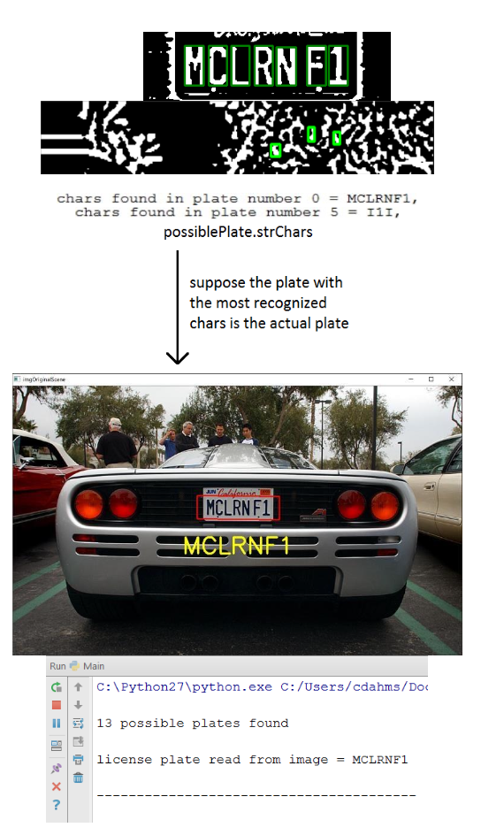
Output

Slide 28
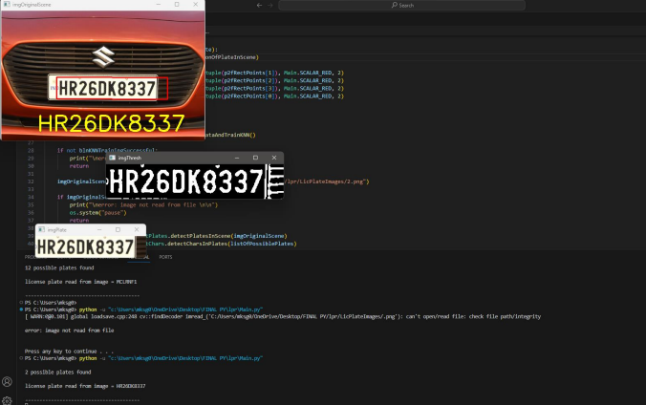
Output

Slide 29
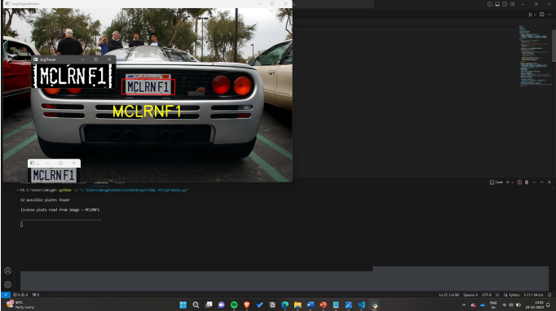
Output

Slide 30
Conclusion
In conclusion, the implemented license plate recognition system showcases the integration of computer vision and machine learning for the purpose of automating license plate identification. The key functionalities include plate detection, character recognition, and the visualization of results on the original scene image. The project leverages the OpenCV library for image processing tasks and employs a KNN model to recognize characters on detected license plates. While the system demonstrates the basic principles of license plate recognition, there are opportunities for further enhancements and refinements.
0:50 / 2:50
#Indian Number Plate Recognition System
Indian Number Plate Recognition System
300 views
Number Plate Detection
Team - 14
SUBSCRIBE 2.0 M

Slide 31
References
22AIE205
M M Shidore, and S P Narote. (2011) “Number Plate Recognition for Indian Vehicles” International Journal of Computer Science and Network Security 11 (2): 143-146
Sang Kyoon Kim, D. W. Kim and Hang Joon Kim. (1996) “A recognition of vehicle license plate using a genetic algorithm based segmentation,” Proceedings of 3rd IEEE International Conference on Image Processing, Lausanne.
Indian Number Plate Recognition System
https://docs.opencv.org/master/
https://github.com/anuj-badhwar/Indian-Number-Plate-Recognition-System

Slide 32
Team Members & Contribution
K.NANDINI
CB.EN.U4AIE22030
M.SUBASHREE
CB.EN.U4AIE22048
VALLETI MAHI VIGNESH CB.EN.U4AIE22056
THATUKURU LAKSHMAN
CB.EN.U4AIE22067

Slide 33
Thank You
Team - 14

